Slide 1
4th Year IoT Project Aquarium Monitoring System: HCFF
Mettre futur logo
Julien Rose, Achille Bayart, Nicolas Rigaudy

Slide 2
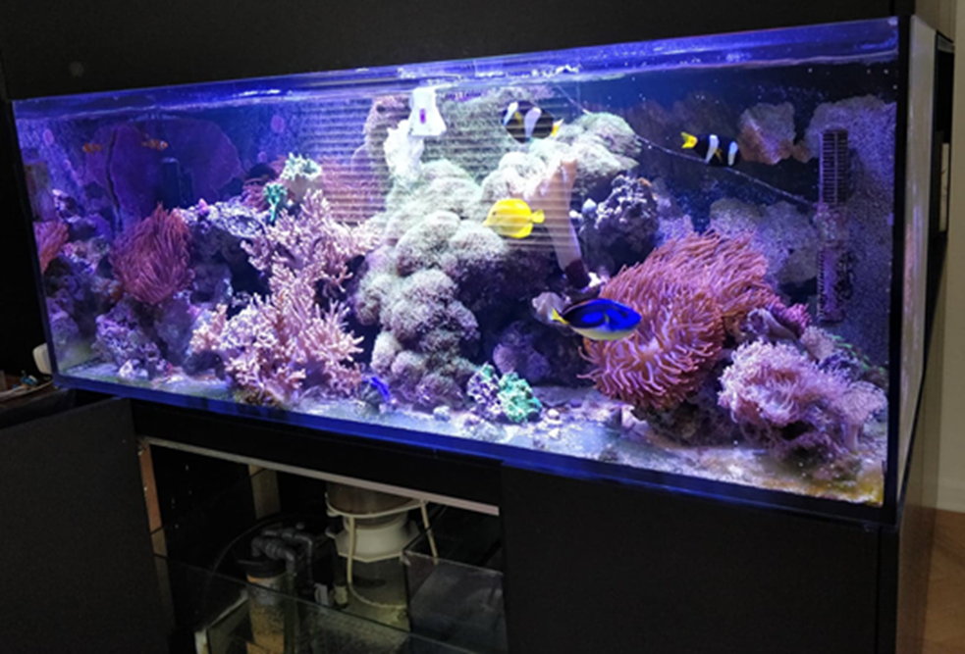
Introduction and context
Aim of the project ?
Working on a seawater aquarium which is composed of many fishes species

Slide 3
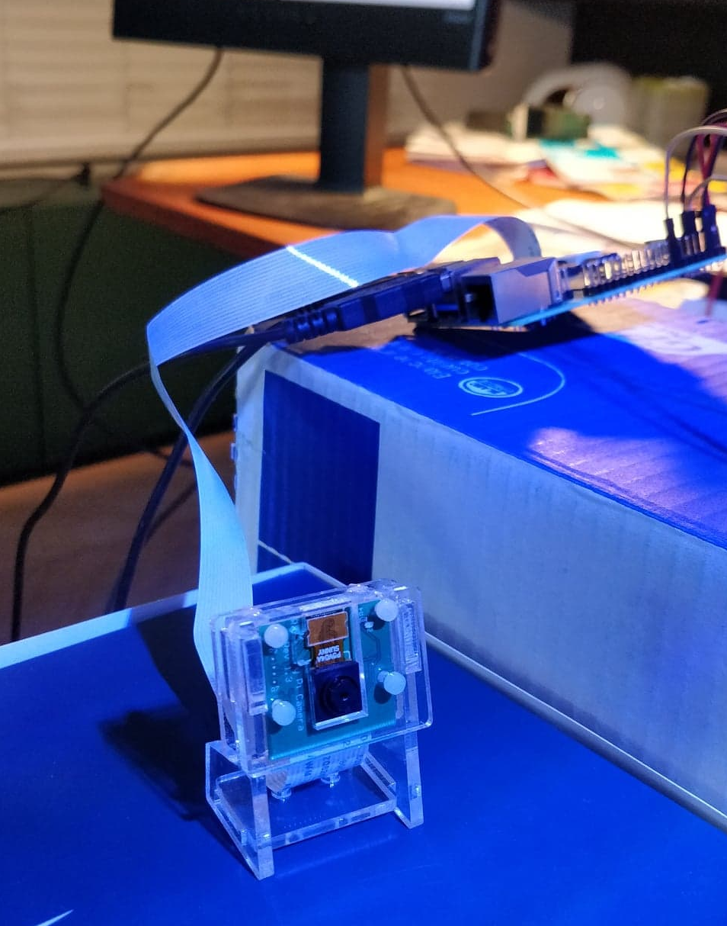
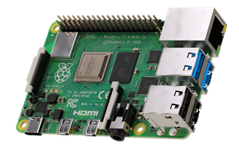
Completed work - Hardware
Raspberry Pi
Raspberry Pi 4 model B
Camera module B01

Slide 4
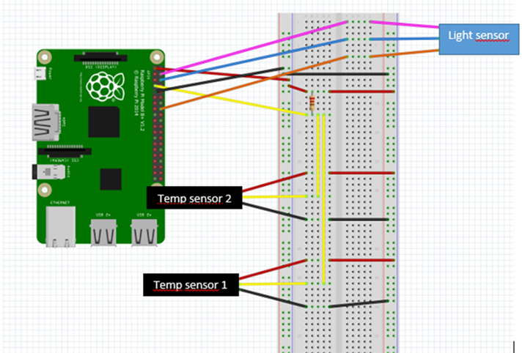
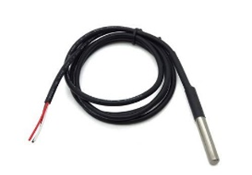
Completed work - Hardware
Temperature
DS18B20 sensor
The connection diagram (made on Fritzing)

Slide 5
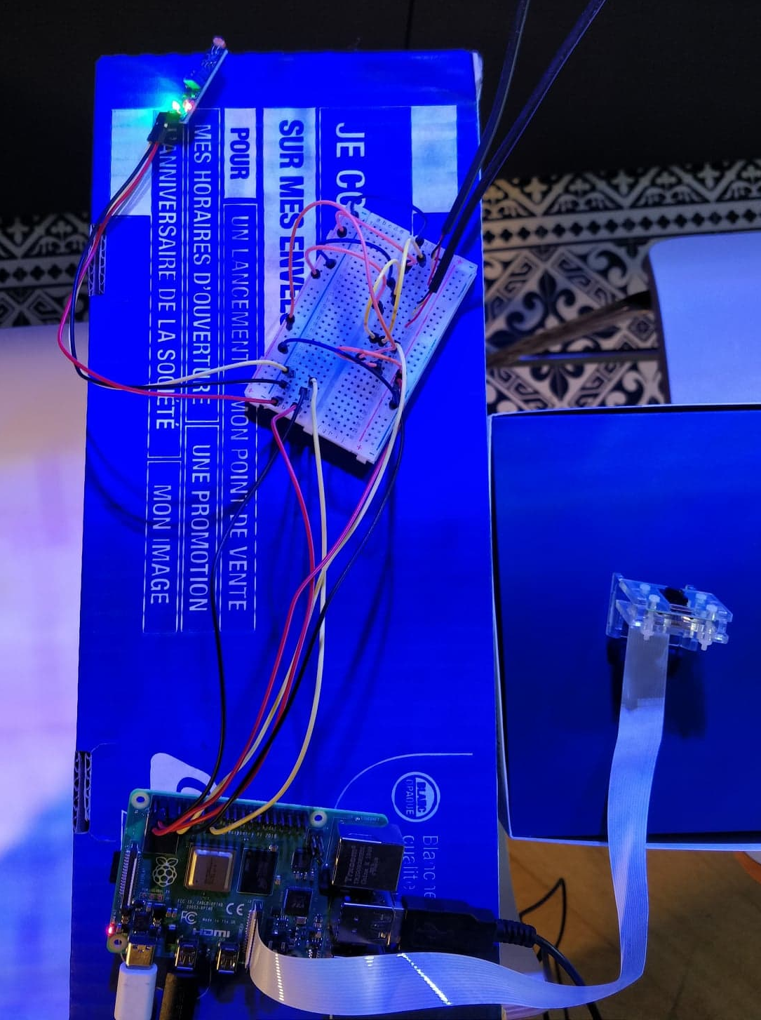
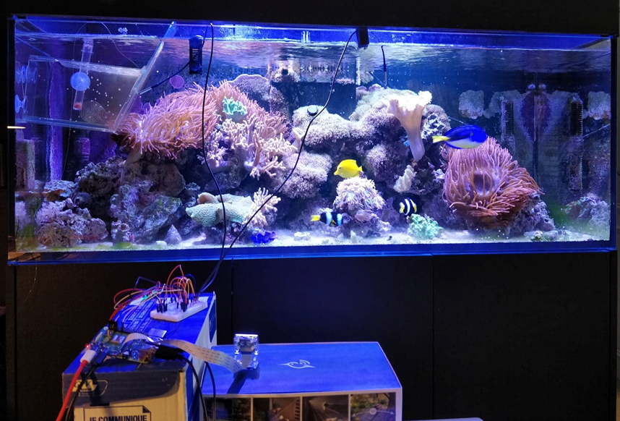
Completed work - Hardware
Temperature
The set-up during the test

Slide 6
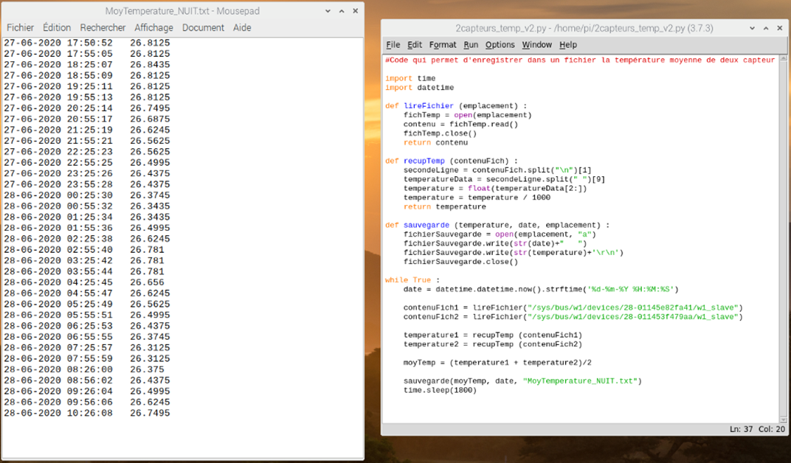
Completed work - Hardware
Temperature
Python code which saves the average temperature every 30min in a text file

Slide 7
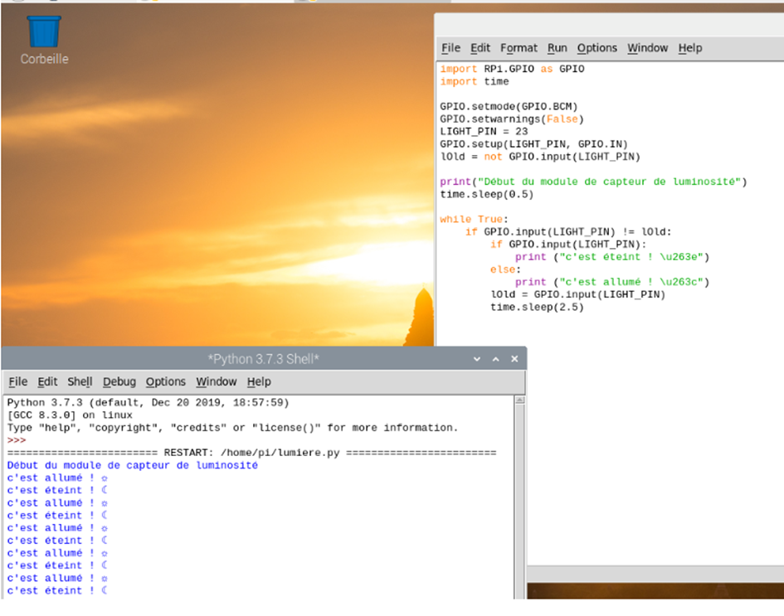
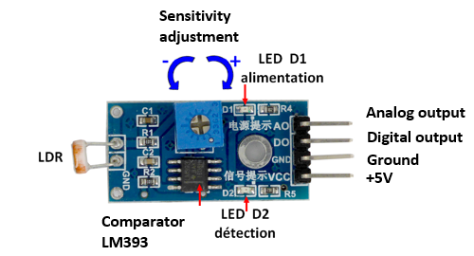
Completed work - Hardware
Brightness
Light sensor module
Brightness sensor Python code

Slide 8
Completed work - Image Recognition
Initial Idea

Slide 9
Completed work - Image Recognition
OpenCv

Slide 10
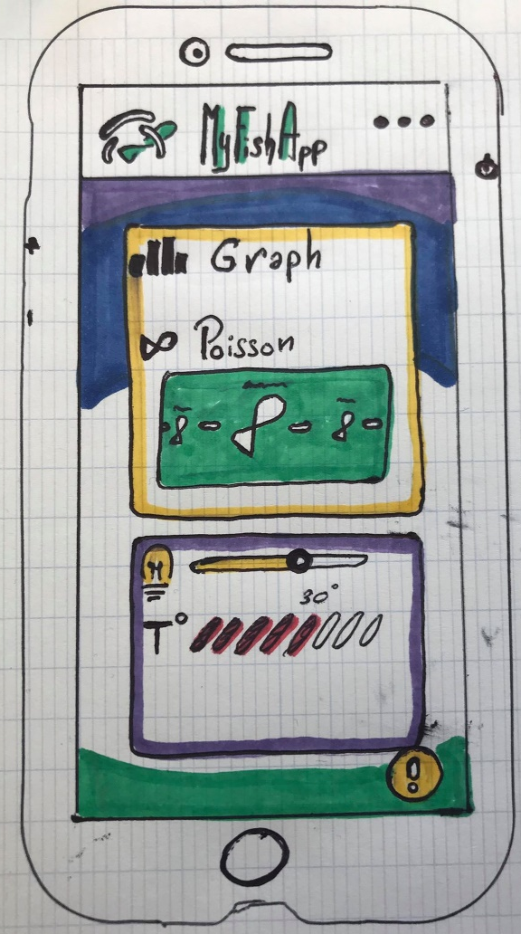
Completed work - Android App
Schematisation:
Meets the Needs:
FP1 : Check the visual information of health of the fish.
FP2 : Show the information of the aquarium for the viewer.
FC1: Monitor the level of water
That Should be:
Entertaining
Intuitive
Smart interface

Slide 11
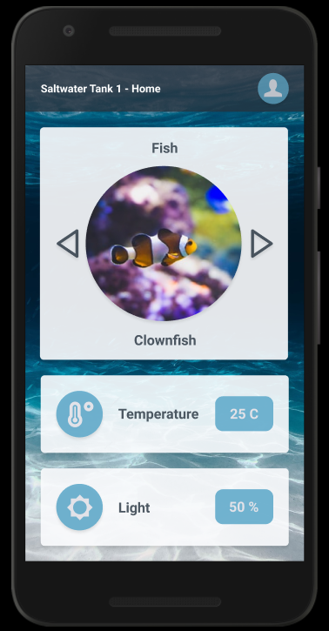
Completed work - Android App
Figma :
Prototype our ideas.
Simplify the way between drawing
and code.
Add code to see how to create
interface.
Entertainment part
Main information of the Aquarium

Slide 12
Completed work - Android App
Android Studio

Slide 13
Completed work - Data collection and linking
Rest Client

Slide 14
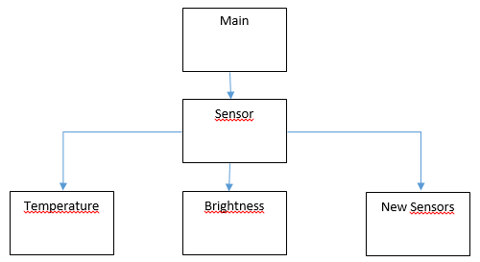
Project perspective
Planned additions
Challenges
How we would like to improve the Python code for the sensors.

Slide 15
Conclusion

Slide 16
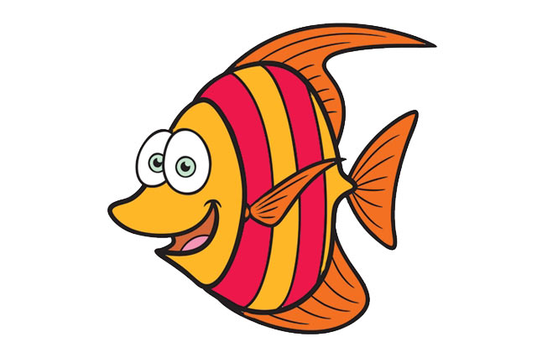
Thanks for listening
And see you in september!

